Slide 1
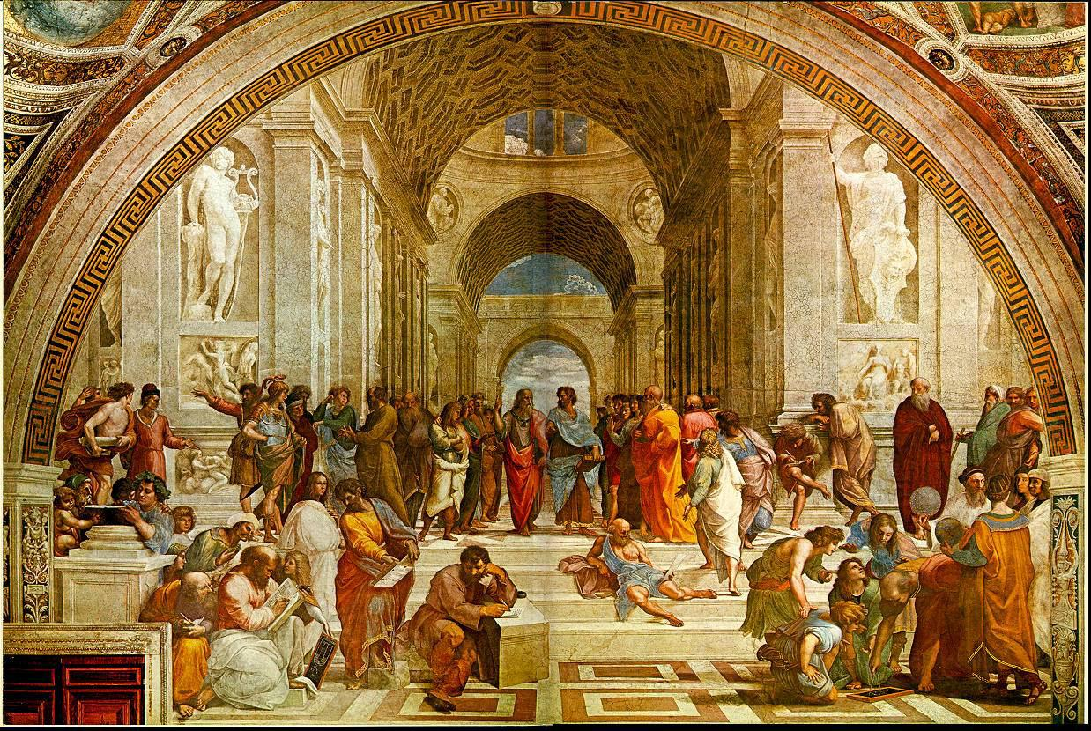
Certificate of Completion
This is to Certify that
Morgan Blayney
Periodus Tabularis Expandus
Call me Mouse Plasma
Drunk on Homocysteine and ammonium
7-fluorobenzo-2-oxa-1, 3-diazole-4-sulfonate
Not Statistically Significantly Different from Kierkegaard
has successfully completed all requirements of the
Great Books Colloquium
Pepperdine University
April 30, 2016
Don Thompson
_____________________

Slide 2
Certificate of Completion
This is to Certify that
Sarah Carey
Musicalis Industrius Expertus
Nine days Until Graduation!
Then Freedom!! Wait, are we ever really free?
Is it illusion? What if we are enslaved? Stuck in another great books class?
has successfully completed all requirements of the
Great Books Colloquium
Pepperdine University
April 30, 2016
Don Thompson
_____________________

Slide 3
Certificate of Completion
This is to Certify that
Kaitlyn Caughfield
Contemplativus Libri
I can Beatya Nietszche
Your Conscience is b-b-b-b-bad to the Bone
You Ressentiment Yourself! Oki Bad, Alyosha Good
has successfully completed all requirements of the
Great Books Colloquium
Pepperdine University
April 30, 2016
Don Thompson
_____________________

Slide 4
Certificate of Completion
This is to Certify that
Joy Chao
Permanente Smilius
Kolya is my Hero
Dmitri is my Homey
Smerdyakov was my High School Principal
has successfully completed all requirements of the
Great Books Colloquium
Pepperdine University
April 30, 2016
Don Thompson
_____________________

Slide 5
Certificate of Completion
This is to Certify that
Irene Chun
Photonicus Bombardierus
Ima Velociraptor Raptor Rapper
Found My ID Card in A Pot of Kimchi
Tucked Inside My Left Ear Cochlea
has successfully completed all requirements of the
Great Books Colloquium
Pepperdine University
April 30, 2016
Don Thompson
_____________________

Slide 6
Certificate of Completion
This is to Certify that
Danielle Claypool
Rhetoric, Logos, Grammaris
Fulbright in Malibu? No Way!
Got my Hooka. I’m Goin’ to Istanbul!
has successfully completed all requirements of the
Great Books Colloquium
Pepperdine University
April 30, 2016
Don Thompson
_____________________

Slide 7
Certificate of Completion
This is to Certify that
Greta Davis
Darwinus Laceratibus
Kalm Katya: Gene Pool is my middle name,
Darwin is my real hero.
Now THAT’s Natural Selection Laceration!
has successfully completed all requirements of the
Great Books Colloquium
Pepperdine University
April 30, 2016
Don Thompson
_____________________

Slide 8
Certificate of Completion
This is to Certify that
Abigail Gibson
Historia Hysteria
Those Who Do Not Study History Are
Doomed to Reread Milton -
Lying Chained to the Burning Lake
has successfully completed all requirements of the
Great Books Colloquium
Pepperdine University
April 30, 2016
Don Thompson
_____________________

Slide 9
Certificate of Completion
This is to Certify that
Mackenzie Jordan
Semper Preparatus
I Psychoanalyzed Myself:
I am Teleologically Suspended in Mokroe
Without the Champagne
has successfully completed all requirements of the
Great Books Colloquium
Pepperdine University
April 30, 2016
Don Thompson
_____________________

Slide 10
Certificate of Completion
This is to Certify that
Ryan Murphy
Tenor Tantrum
Heels Up, Fists Pumping,
Gimme That Pestle!
has successfully completed all requirements of the
Great Books Colloquium
Pepperdine University
April 30, 2016
Don Thompson
_____________________

Slide 11
Certificate of Completion
This is to Certify that
Jessica Ragsdale
Vocare Vocare Vocare
Silently She Enters the Room
Old Hickory’s Answer to Grushenka
Pepe’ Le Pew
has successfully completed all requirements of the
Great Books Colloquium
Pepperdine University
April 30, 2016
Don Thompson
_____________________

Slide 12
Certificate of Completion
This is to Certify that
Ashley Rothballer
Entropy Shmentropy - Differentialis Positivus
Albert Einstein, Max Planck,
Niels Bohr, & Richard Feynman
Rolled into One
Relatively Speaking
has successfully completed all requirements of the
Great Books Colloquium
Pepperdine University
April 30, 2016
Don Thompson
_____________________

Slide 13
Certificate of Completion
This is to Certify that
Meagan Smith
Joanna Silentio
Run Silent, Run Deep
“Wisp of Towhead”
Social Psychologist Extraordinaire
has successfully completed all requirements of the
Great Books Colloquium
Pepperdine University
April 30, 2016
Don Thompson
_____________________

Slide 14
Certificate of Completion
This is to Certify that
Megan Stapleton
Cogito, Ergo Psyche
Everywhere I go, I see Slanting Rays
Time to Get my Groove Back &
Move out of Lemon Grove
has successfully completed all requirements of the
Great Books Colloquium
Pepperdine University
April 30, 2016
Don Thompson
_____________________

Slide 15
Certificate of Completion
This is to Certify that
Bryan Starck
Veni, Vidi, Flapjacki
I Love Pancakes! Pancakes! Pancakes!
Syrup & Pancakes!
has successfully completed all requirements of the
Great Books Colloquium
Pepperdine University
April 30, 2016
Don Thompson
_____________________

Slide 16
Certificate of Completion
This is to Certify that
Jared Taylor
Mozart, Monteverdi, Maestro Magnifico
Tao Light Spreading in All Directions, Ars Liberalis,
Teacher, Student, Creator
See You in Firenze!
has successfully completed all requirements of the
Great Books Colloquium
Pepperdine University
April 30, 2016
Don Thompson
_____________________

Slide 17
Certificate of Completion
This is to Certify that
Mark Wasson
Cranium Creativus
Call Me Elon Musk
Captain Electric Scruff Tesla -
The Enabler
has successfully completed all requirements of the
Great Books Colloquium
Pepperdine University
April 30, 2016
Don Thompson
_____________________

